Slide 1
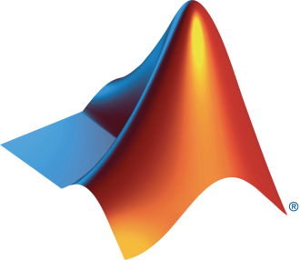
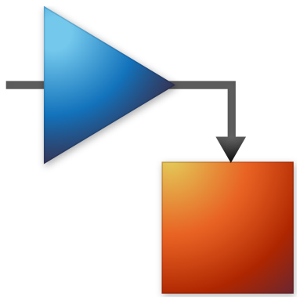
University and MathWorks Present: Signal Processing Onramp

Slide 2
Today:
6:15 pm – 6.30 pm: Set-up
Intro to Signal Processing
Create a MathWorks account
Log in to Signal Processing Onramp / Test MATLAB Online
6.30 pm – 8.00 pm: Signal Processing Onramp(on your own)

Slide 3



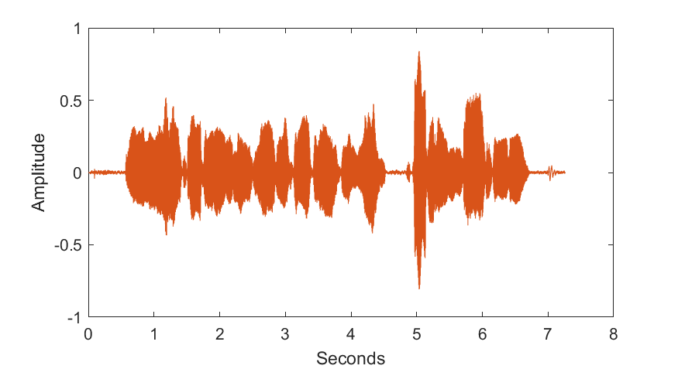
Signals
A function that describes data about a physical phenomena
Examples:
Sounds
Images
Sensors
Light sensor
Proximity sensor
Pressure Sensor

Slide 4
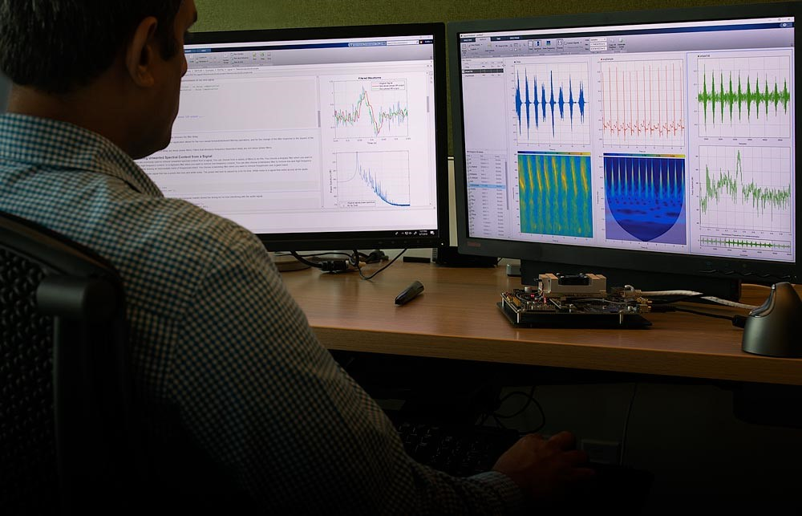
Signal processing
Field of modifying and synthesizing signals to get desired results
Signals are often companied by noise – unwanted modifications to signal
Mathematical operations performed to remove noise or amplify signal

Slide 5
Signal Processing Workflow
Pre-process
Analyze
Filter

Slide 6
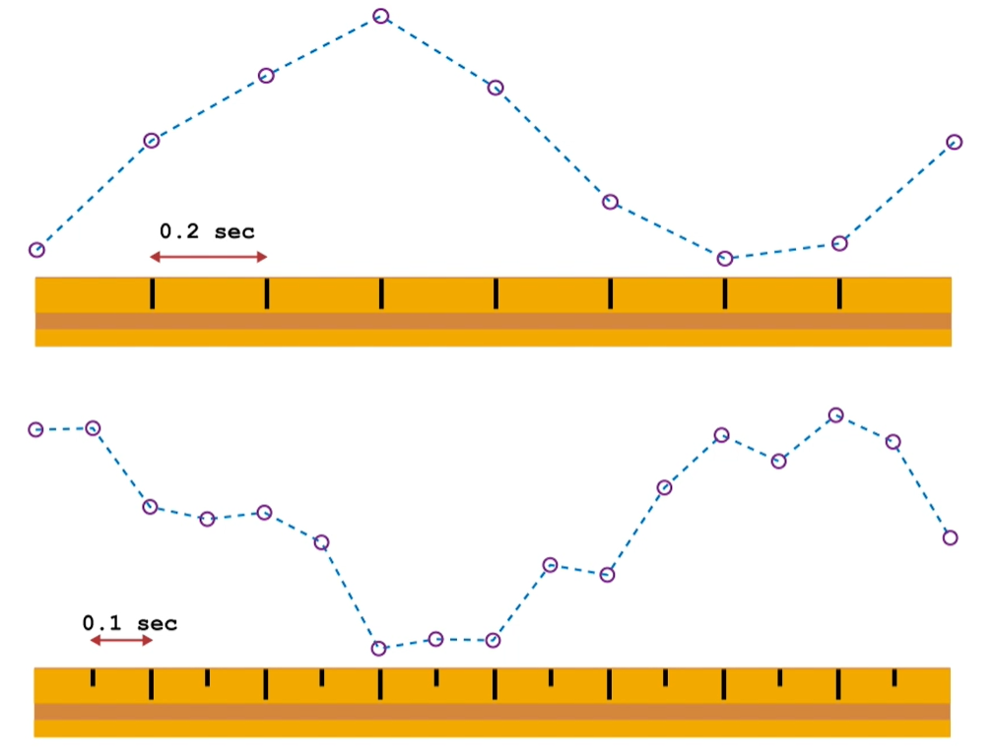
Pre-process
Imported signals often aren’t perfect - Irrelevant trends and noise can be found
When comparing two signals, they must match:
Sample time
Time steps
Time range

Slide 7
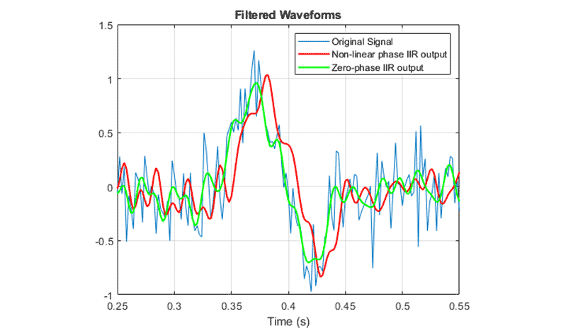
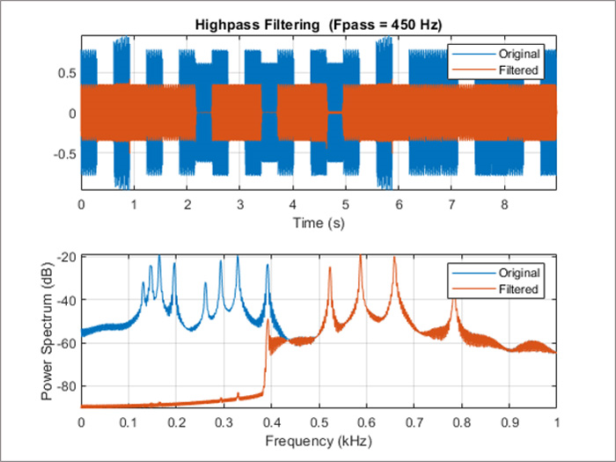
Filtering
To analyze the signal of interest, filters may have to be applied to isolate or amplify the signal
Low/high pass filter
Zero-Phase Filter
Phase filter
Finite impulse response filter
Etc.

Slide 8
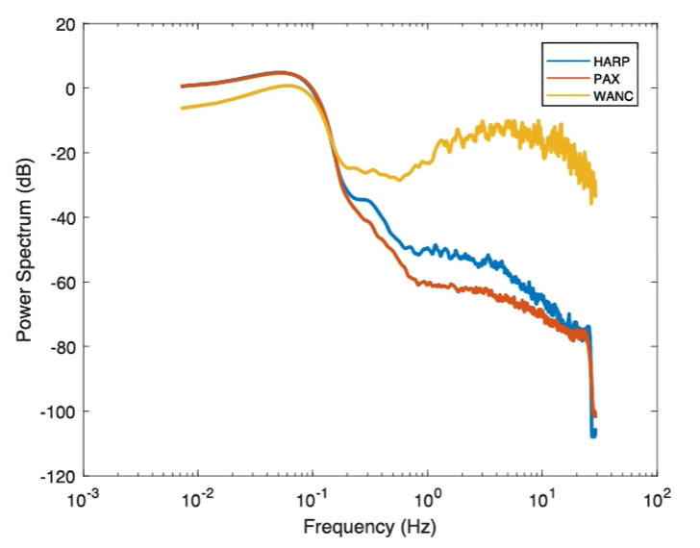
Analyze
Signals are often made up of different frequencies
Power Spectrum vs. Frequency is a common way for examining frequencies in a signal
Fourier transform is used find the frequencies in a signal

Slide 9
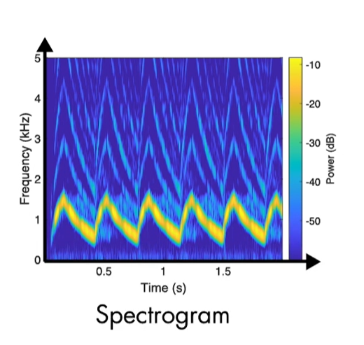
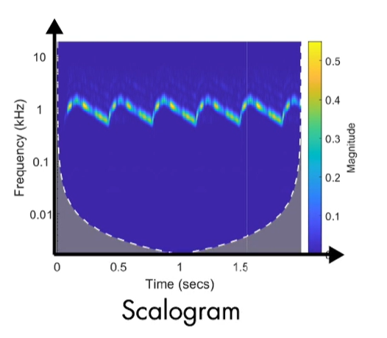
Analyze
Amplitude-time and power-frequency plots don’t provide a lot of information on their own
Time-frequency plots should be used to analyze full spectrum of signal
Spectrogram: Fourier
Scalogram: Wavelets

Slide 10
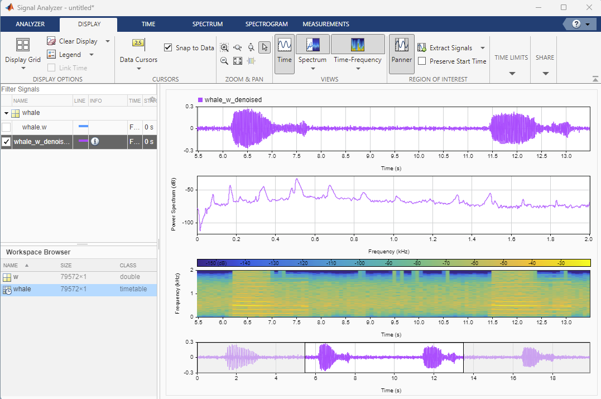
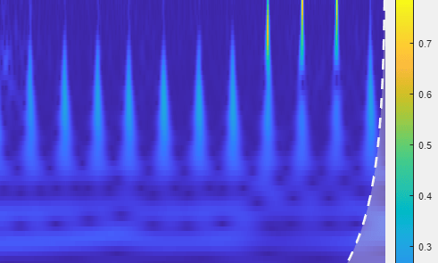
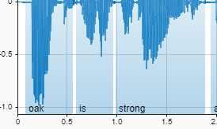
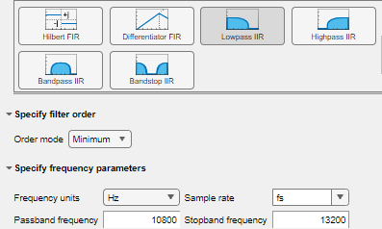
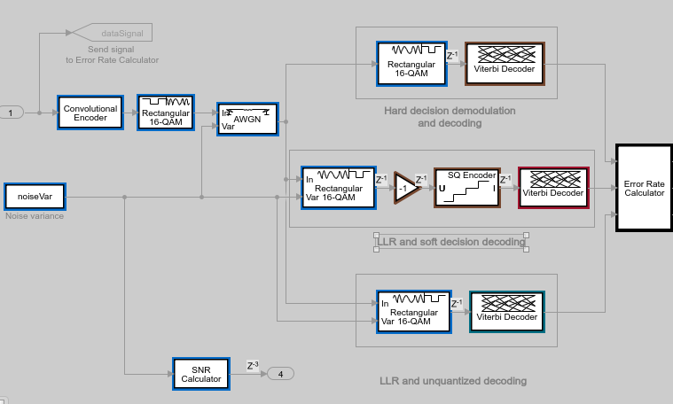
Signal Processing with MATLAB and Simulink
Interactive Signal Visualization and Analysis
Time-Frequency Analysis
AI for Signal Processing Applications
Digital Filtering and DSP Algorithms
Simulink for Signal Processing

Slide 11
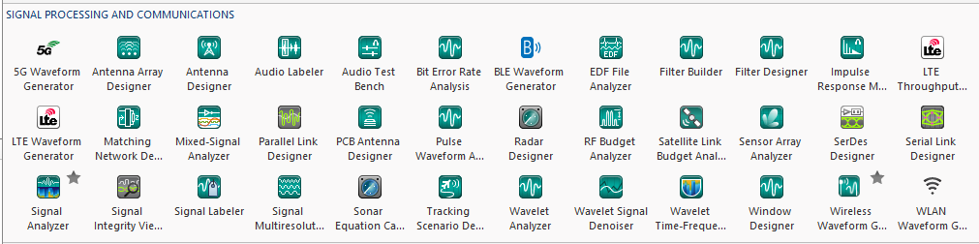
Interactive Signal Visualization and Analysis
Apps
Scopes
Notes:
The first thing we’ll talk about isn’t code, MATLAB has a lot of apps, and this is especially true in signal processing. These are mostly for analyzing logged data. And if I’m using live data, I can use scopes, which we’ll talk about later. We’ll focus on Signal Analyzer, which is the main tool for exploring a signal interactively. It’s a great place to start working on your problem.

Slide 12
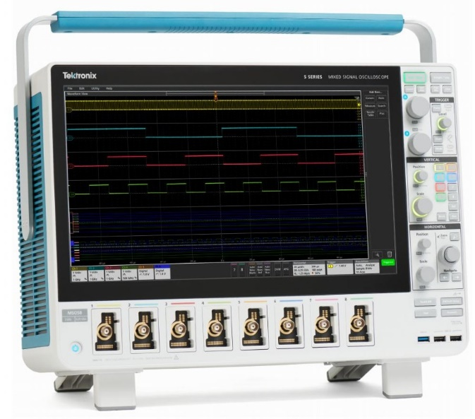
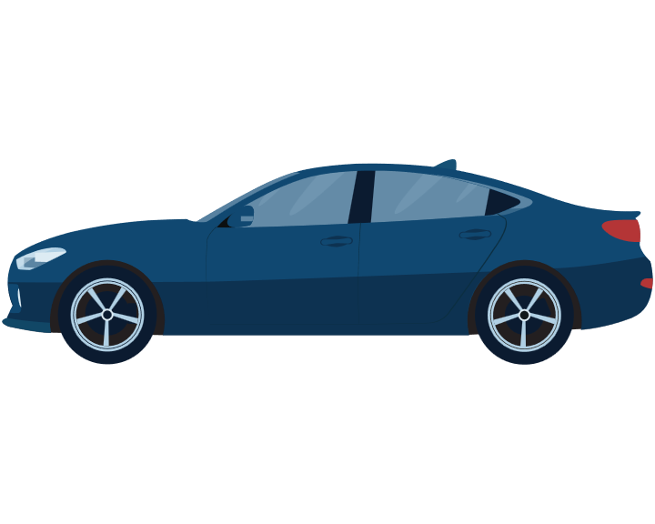
Example: Charge Pulse Identifier Signal Analyzer
Electric vehicle battery state of health (SOH) estimator

Slide 13
Example: Charge Pulse Identifier Signal Analyzer
We have a current and voltage signal from a battery in an EV
The battery team determined the constant current stage of a charge cycle is ideal for estimating battery SOH
Task: Identify characteristics to differentiate these regions
Constant Current
Constant Voltage
Charge Cycle
Rest period
Discharge (usage)

Slide 14
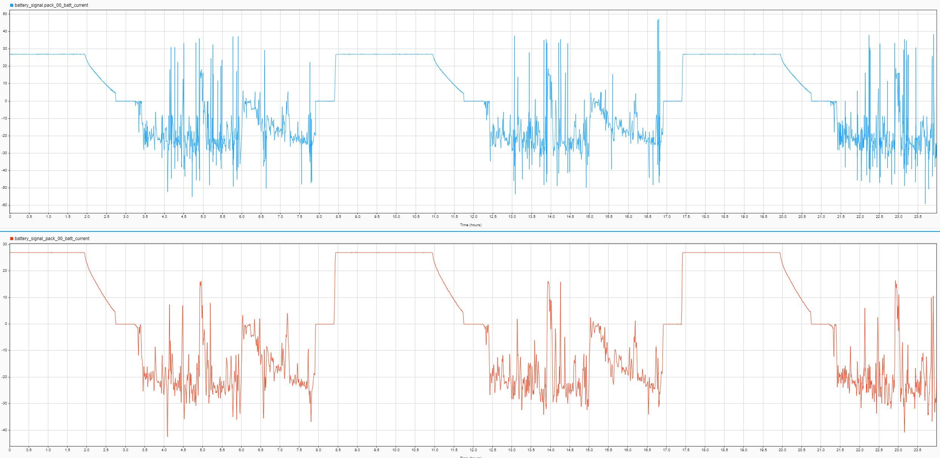
Example: Charge Pulse Identifier Signal Analyzer
Thresholding

Slide 15
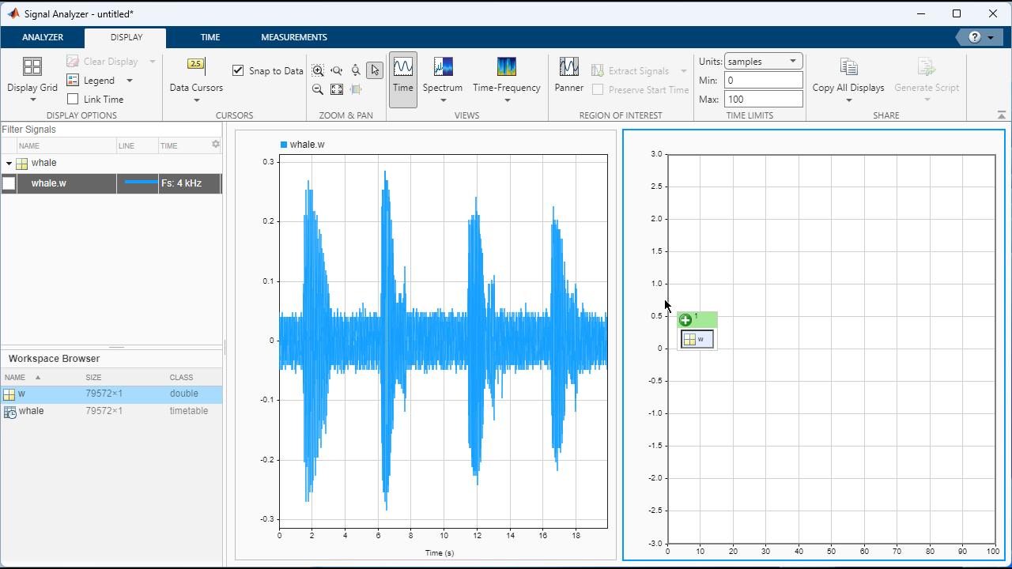
Bring signals into Signal Analyzer
Select any signal available in the MATLAB workspace
Add sample rate information or include it with built in time series data types
Notes:
Starting with the first steps of a signal exploration workflow, you can import any signal in your MATLAB workspace to visualize it by dragging and dropping in the Signal Analyzer app. Signals can be imported as numerical data, and you can add time information such as sample rate and start time if desired. This also supports signals stored in data types that already contain time information, and this is displayed in on the x-axis of the plot.

Slide 16
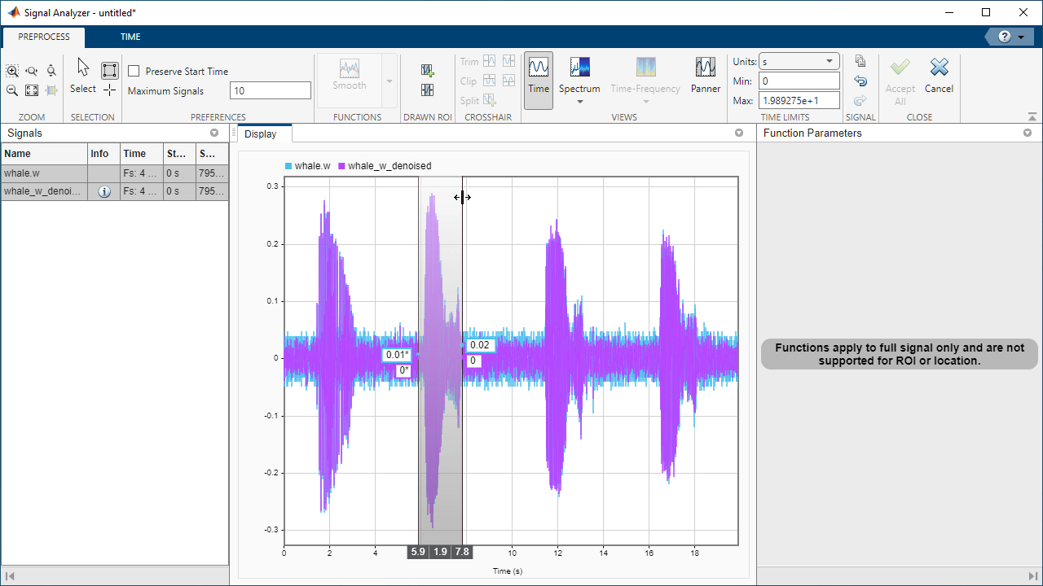
Interactive Signal Preprocessing
Pan through and view multiple signals
Extract regions of interest
Trim, clip, and split signals
Notes:
Often we need to edit signals based on properties that are easier to evaluate visually or comparatively, so we introduced signal editing to Signal Analyzer. You can overlap or view signals side by side - and pan through different regions of a signal. Pre-processing mode includes the ability to trim, clip, extract, and crop signals. In the last few releases we included support for complex and non-finite signals.

Slide 17
Explore frequency visually
View spectrum and persistence spectrum
View spectrogram and scalogram
Logarithmic frequency axis
Control window length, DFT points, resolution bandwidth
Notes:
Analyzing the frequency components of signals is an important part of signal processing. We make it easy to view different ways of computing spectra for your signals. This includes the signal spectrum, spectrograms, scalograms, and persistence spectra. They are all adjustable to allow you to change the parameters of the calculations – such as leakage, time resolution, binning, frequency resolution and spectrum reassignment
if you've used it before you may have noticed that earlier versions were missing log scale for amplitudes in frequency plots… if so you'll like to know that is now sorted from R2022b

Slide 18
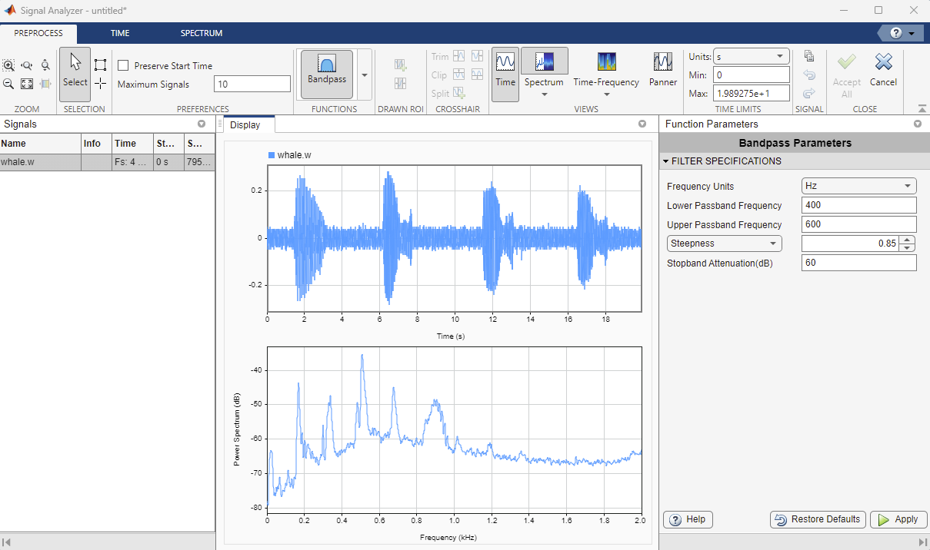
Filter signals without writing code
Lowpass, highpass, bandpass, and bandstop filters
Remove trends and compute signal envelopes
Denoise with wavelets
Resample signals
Use custom functions
Notes:
It can be hard to know which filter with what parameters will suit your application best. So signal analyzer let’s you quickly apply filters and other signal processing techniques and see the results, without writing any code. You can see the effects directly in the time and frequency domains, compare results, and adjust filter parameters as needed.

Slide 19
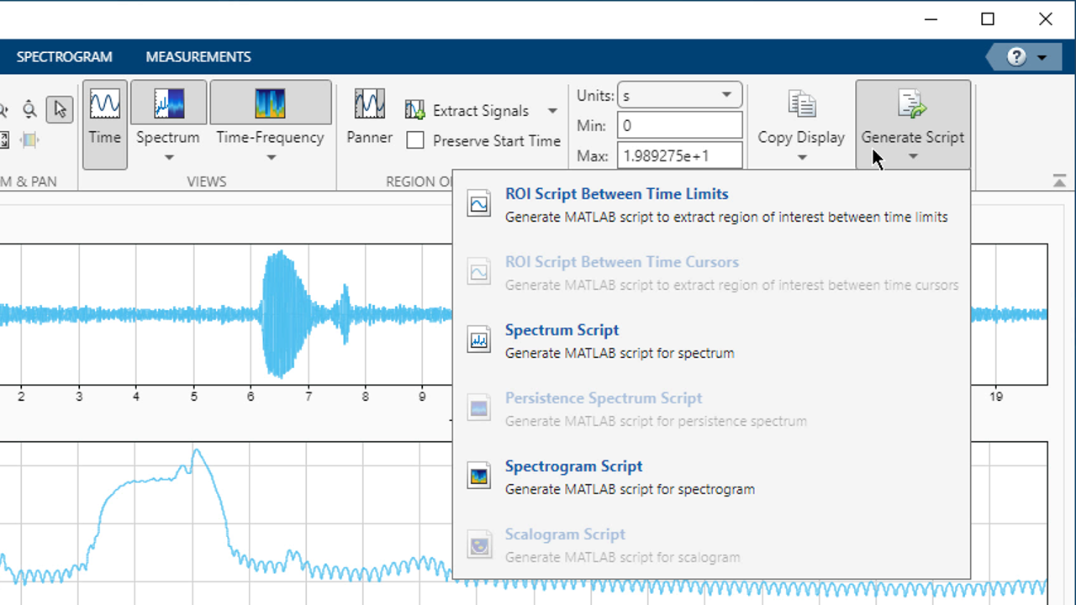
Share analysis with others
Generate functions from preprocessing steps
Share plots as scripts or figures
Export edited signals to workspace or files
Notes:
So you’ve gone through the iterative process of exploring, editing, and processing your signals. Now you want to share the results with your colleagues, or take the signals back to MATLAB for use in your application. You can share the plots you’ve built as MATLAB scripts or images. Export the preprocessing steps as functions so they can be repeated inside or outside of the app, and use and share the edited signals in MATLAB. Signal Analyzer sessions can also be saved and reloaded in the app.

Slide 20
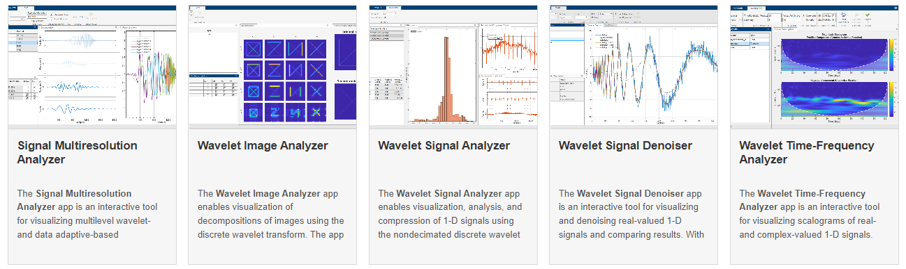
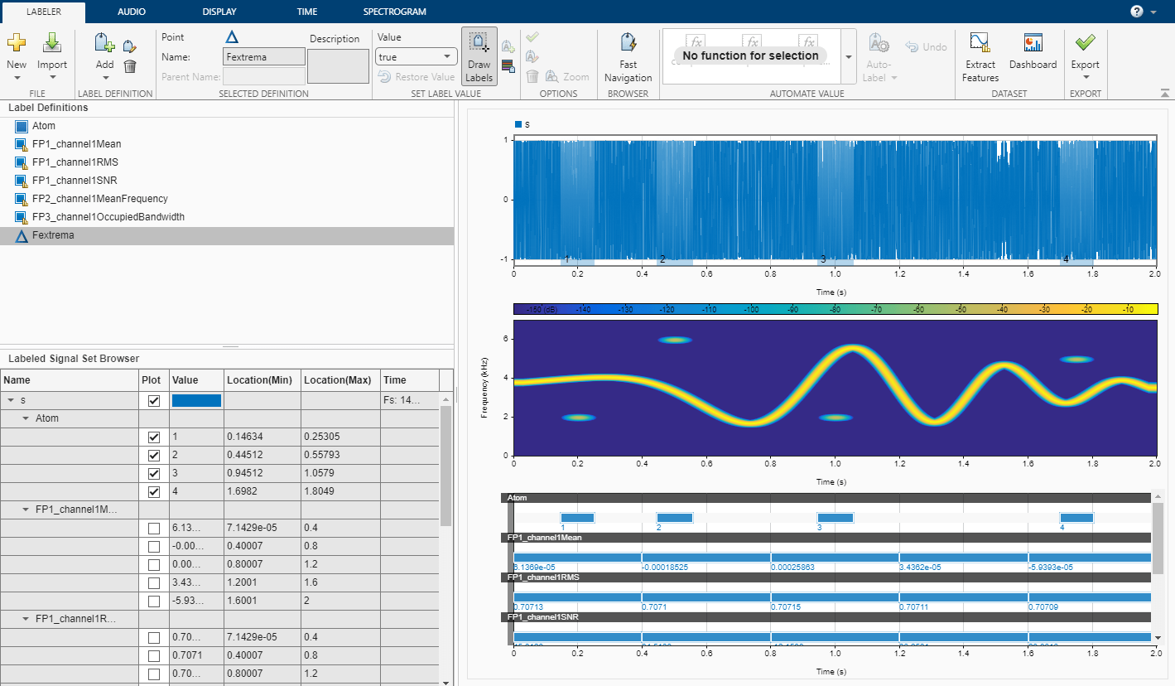
More interactive tools
Signal Labeler
Interactive tool for analysis or AI applications
Wavelet Apps
Interactive tools for applying wavelet techniques
Notes:
Signal Labeler a great place to continue on the problem we were just working on. Wavelet Apps to experiment through practice and trial and error with mathematical methods that you may not know much about but may provide tremendous help to complex problems even with little insider knowledge on wavelets

Slide 21
Viewing live signals with signal processing scopes

Slide 22
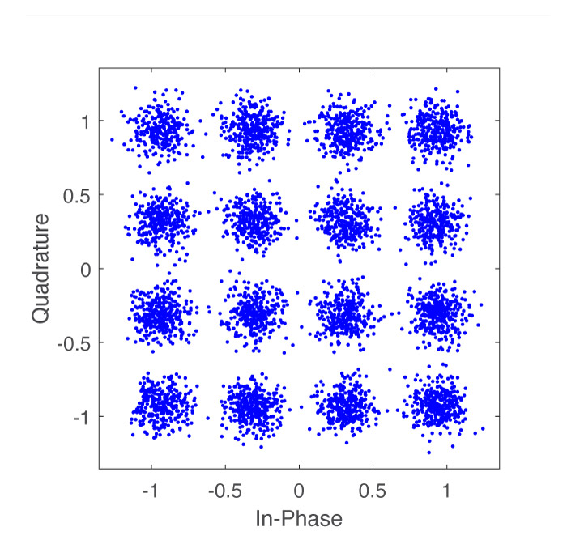
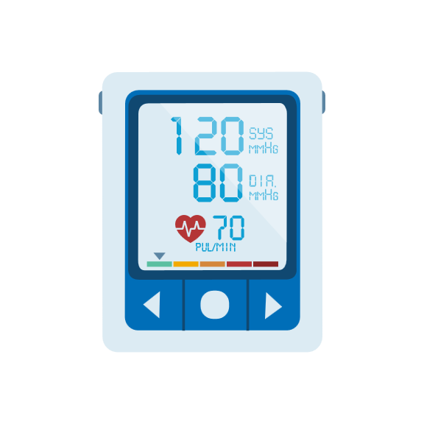
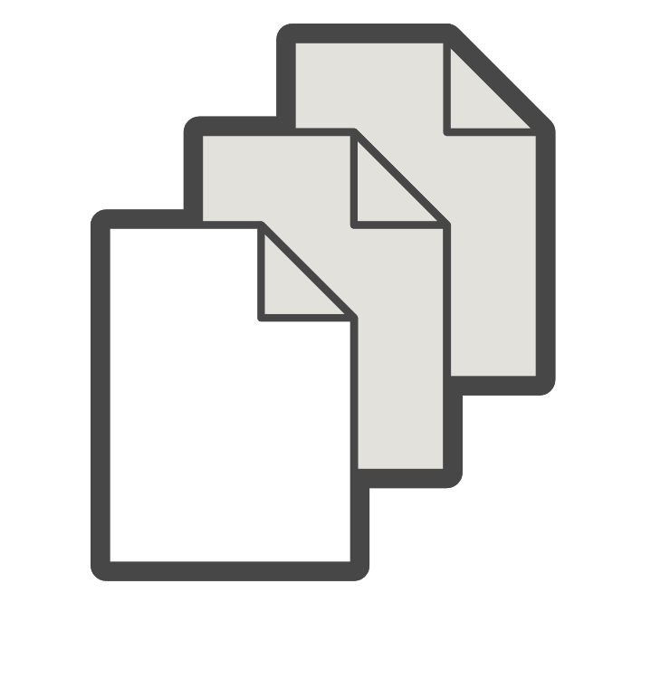
Live signals
Some signals are more conveniently viewed as they become available, for example
Signals from simulation
Signals from a device
Signals too large to work on at once

Slide 23
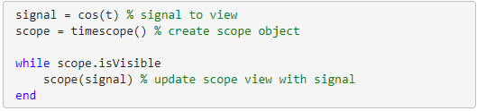
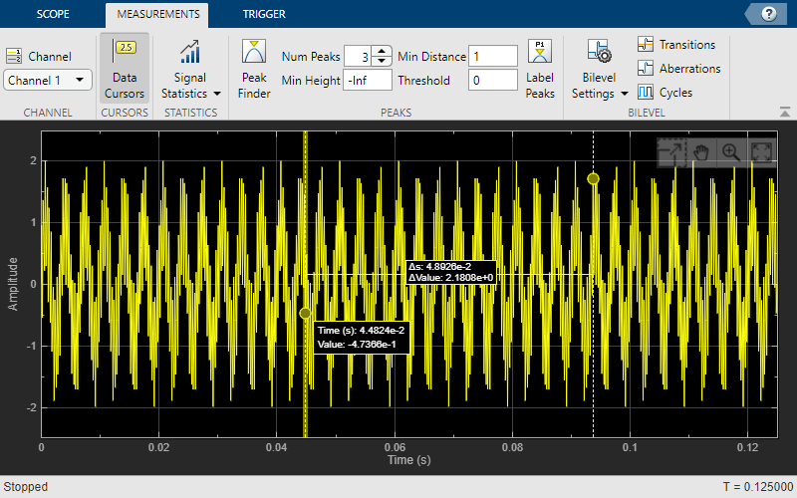
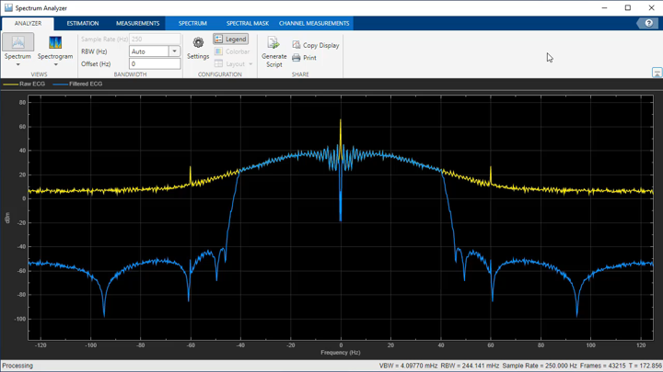
Signal processing scopes
Objects used to view live signals in MATLAB and Simulink
timescope
spectrumAnalyzer

Slide 24
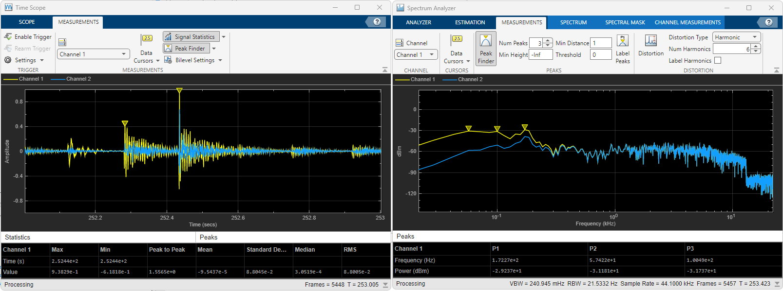
Interactive Signal Visualization and Analysis
Apps for viewing and analyzing logged signals
Scopes for viewing and measuring live signals

Slide 25
How can signal processing be used in the real world?

Slide 26
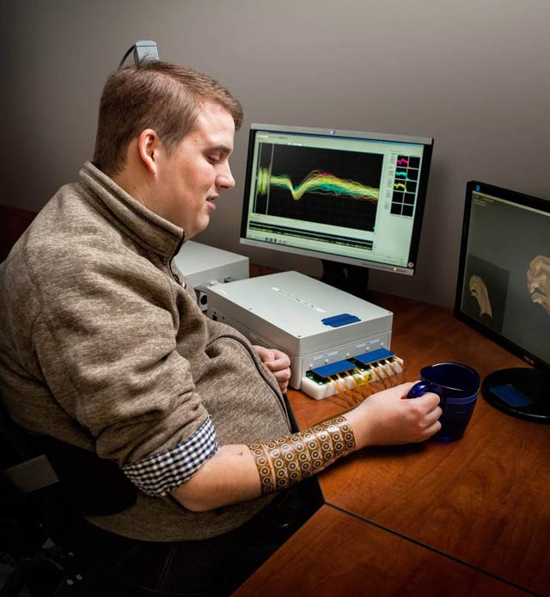
Battelle Neural Bypass Technology Restores Movement to a Paralyzed Man’s Arm and Hand
Challenge
Restore arm and hand control to a quadriplegic man by processing signals from an electrode array implanted in his brain
Solution
Use MATLAB to analyze signal samples, apply machine learning to classify patterns mapped to movements, and generate actuation signals for a neuromuscular electrical stimulator
Results
Control over paralyzed hand and arm restored
Real-time processing performance achieved
Interdisciplinary collaboration enabled
Patient using the Battelle NeuroLife system.
“The algorithms we developed using MATLAB gave the participant back basic control of his arm and hand. By the end of the study, he could grip a bottle, pour out its contents, and set it down, as well as pick up a stir stick and execute a stirring motion.” - David Friedenberg, Battelle
Link to user story
Notes:
Industries: Medical Devices
Application Areas: Data analytics, Digital signal processing
Capabilities: Data analysis, Algorithm development, Machine learning
Products Used: MATLAB, Wavelet Toolbox
Country: USA
Battelle Neural Bypass Technology Restores Movement to a Paralyzed Man’s Arm and Hand
When disease or injury disrupts the neural pathways connecting the brain’s motor cortex to muscles, the result is often permanent paralysis. A team of engineers, scientists, and statisticians at Battelle have developed a technology that bypasses damaged neural pathways. Known as Battelle NeuroLife™, the system is the first ever to successfully restore muscle control using intracortically recorded neural signals in a human. It has enabled a quadriplegic man to regain control of his right forearm, hand, and fingers.
NeuroLife includes signal processing and machine learning algorithms developed in MATLAB®. These algorithms process and interpret signals from a microelectrode array implanted in the study participant’s brain. When the participant thinks of a specific hand movement, the algorithms decode the resultant brain signals, identify the intended movement, and generate signals that stimulate the patient’s arm to perform the movement.”
Challenge
Neurosurgeons from The Ohio State University Wexner Medical Center implanted a microelectrode array into the volunteer participant’s left primary motor cortex. The array uses 96 individual electrodes to record neural activity. At 30,000 samples per second, the electrodes produce almost 300,000 samples every 100 milliseconds.
To translate this data into specific hand movements, Battelle engineers needed to extract meaningful features, apply classification algorithms to identify patterns in those features, and map the patterns to the participant’s intended hand movements. The engineers then needed to control 130 channels of a neuromuscular electrical stimulator (NMES) sleeve on the participant’s right arm. Even a seconds-long delay between thought and movement would have made the movement too unnatural, rendering the entire system impractical. As a result, all data processing, classification, and decoding had to be done in real time. To achieve performance approaching natural motion, the system had to update 10 times per second, which meant completing all processing steps in less than 100 milliseconds.
“The algorithms we developed using MATLAB gave the participant back basic control of his arm and hand. By the end of the study, he could grip a bottle, pour out its contents, and set it down, as well as pick up a stir stick and execute a stirring motion.”
- David Friedenberg, Battelle
Solution
Battelle used MATLAB to develop signal processing and machine learning algorithms and run the algorithms in real time.
The participant was shown a computer-generated virtual hand performing movements such as wrist flexion and extension, thumb flexion and extension, and hand opening and closing, and instructed to think about making the same movements with his own hand.
Working in MATLAB, the team developed algorithms to analyze data from the 96 channels in the implanted electrode array. Using Wavelet Toolbox™, they performed wavelet decomposition to isolate the frequency ranges of the brain signals that govern movement.
They performed transforms on the results of the decomposition in MATLAB to calculate mean wavelet power (MWP), reducing the 3000 features captured during each 100 millisecond window for a single channel to a single value.
The resulting 96 MWP values were used as feature vectors for machine learning algorithms that translate the features into individual movements.
The team used MATLAB to test several machine learning techniques, including discriminant analysis and support vector machines (SVM), settling on a custom SVM optimized for performance.
During testing sessions, the team trained the SVM by having the participant attempt the movements shown in the videos. They used the trained SVM’s output to animate a computer-generated virtual hand that the participant could manipulate on screen. The same SVM output was scaled and used to control the 130 channels of the NMES sleeve.
While the participant moved his arm and hand to perform simple movements, all signal processing, decoding, and machine learning algorithms were run in MATLAB in real time on a desktop computer.
Battelle engineers are currently using MATLAB to develop algorithms for the second- generation NeuroLife system, which will incorporate accelerometers and other sensors to enable the control algorithms to monitor the position of the arm and detect fatigue.
Results
■ Control over paralyzed hand and arm restored. “The algorithms we developed using MATLAB to decode signals from an implanted microelectrode array and actuate an NMES sleeve gave the participant back basic control of his arm and hand,” says David Friedenberg, principal research statistician at Battelle. “By the end of the study, he could grip a bottle, pour out its contents, and set it down, as well as pick up a stir stick and execute a stirring motion.”
■ Real-time processing performance achieved. “Our algorithms performed all the necessary wavelet decomposition, decoding, and other processing within 60–70 milliseconds running in MATLAB,” says Nick Annetta, research scientist at Battelle.”
■ Interdisciplinary collaboration enabled. “I’m a statistician, Nick is an electrical engineer, and lots of other engineers and interns worked on the project,” says Friedenberg. “The whole team was comfortable with MATLAB—it was the language that we all had in common.”
Learn more Battelle: www.battelle.org/neurolife

Slide 27
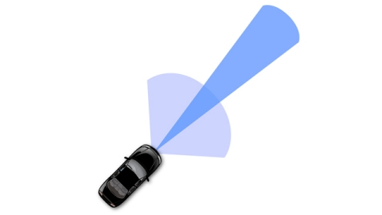
Delphi Develops Radar Sensor Alignment Algorithm for Automotive Active Safety System
Challenge
Deliver a production automotive radar sensor alignment algorithm in four weeks
Solution
Adopted MATLAB to develop and implement a radar sensor alignment algorithm that calculates sensor misalignment angles from raw radar detection and host vehicle speed.
Results
Generated C code as efficient as handwritten C code for this algorithm
Algorithm changes easily verified and coded in seconds
“MATLAB is my preferred tool because it speeds algorithm design and improvement. I can do the data analysis, algorithm development, algorithm visualization, and simulation in one place and then generate C code that is reliable, efficient, and easy for software engineers to integrate within a larger system.”
Liang Ma, Delphi
Link to user story
Notes:
Industries: Medical Devices
Application Areas: Data analytics, Digital signal processing
Capabilities: Data analysis, Algorithm development, Machine learning
Products Used: MATLAB, Wavelet Toolbox
Country: USA
Battelle Neural Bypass Technology Restores Movement to a Paralyzed Man’s Arm and Hand
When disease or injury disrupts the neural pathways connecting the brain’s motor cortex to muscles, the result is often permanent paralysis. A team of engineers, scientists, and statisticians at Battelle have developed a technology that bypasses damaged neural pathways. Known as Battelle NeuroLife™, the system is the first ever to successfully restore muscle control using intracortically recorded neural signals in a human. It has enabled a quadriplegic man to regain control of his right forearm, hand, and fingers.
NeuroLife includes signal processing and machine learning algorithms developed in MATLAB®. These algorithms process and interpret signals from a microelectrode array implanted in the study participant’s brain. When the participant thinks of a specific hand movement, the algorithms decode the resultant brain signals, identify the intended movement, and generate signals that stimulate the patient’s arm to perform the movement.”
Challenge
Neurosurgeons from The Ohio State University Wexner Medical Center implanted a microelectrode array into the volunteer participant’s left primary motor cortex. The array uses 96 individual electrodes to record neural activity. At 30,000 samples per second, the electrodes produce almost 300,000 samples every 100 milliseconds.
To translate this data into specific hand movements, Battelle engineers needed to extract meaningful features, apply classification algorithms to identify patterns in those features, and map the patterns to the participant’s intended hand movements. The engineers then needed to control 130 channels of a neuromuscular electrical stimulator (NMES) sleeve on the participant’s right arm. Even a seconds-long delay between thought and movement would have made the movement too unnatural, rendering the entire system impractical. As a result, all data processing, classification, and decoding had to be done in real time. To achieve performance approaching natural motion, the system had to update 10 times per second, which meant completing all processing steps in less than 100 milliseconds.
“The algorithms we developed using MATLAB gave the participant back basic control of his arm and hand. By the end of the study, he could grip a bottle, pour out its contents, and set it down, as well as pick up a stir stick and execute a stirring motion.”
- David Friedenberg, Battelle
Solution
Battelle used MATLAB to develop signal processing and machine learning algorithms and run the algorithms in real time.
The participant was shown a computer-generated virtual hand performing movements such as wrist flexion and extension, thumb flexion and extension, and hand opening and closing, and instructed to think about making the same movements with his own hand.
Working in MATLAB, the team developed algorithms to analyze data from the 96 channels in the implanted electrode array. Using Wavelet Toolbox™, they performed wavelet decomposition to isolate the frequency ranges of the brain signals that govern movement.
They performed transforms on the results of the decomposition in MATLAB to calculate mean wavelet power (MWP), reducing the 3000 features captured during each 100 millisecond window for a single channel to a single value.
The resulting 96 MWP values were used as feature vectors for machine learning algorithms that translate the features into individual movements.
The team used MATLAB to test several machine learning techniques, including discriminant analysis and support vector machines (SVM), settling on a custom SVM optimized for performance.
During testing sessions, the team trained the SVM by having the participant attempt the movements shown in the videos. They used the trained SVM’s output to animate a computer-generated virtual hand that the participant could manipulate on screen. The same SVM output was scaled and used to control the 130 channels of the NMES sleeve.
While the participant moved his arm and hand to perform simple movements, all signal processing, decoding, and machine learning algorithms were run in MATLAB in real time on a desktop computer.
Battelle engineers are currently using MATLAB to develop algorithms for the second- generation NeuroLife system, which will incorporate accelerometers and other sensors to enable the control algorithms to monitor the position of the arm and detect fatigue.
Results
■ Control over paralyzed hand and arm restored. “The algorithms we developed using MATLAB to decode signals from an implanted microelectrode array and actuate an NMES sleeve gave the participant back basic control of his arm and hand,” says David Friedenberg, principal research statistician at Battelle. “By the end of the study, he could grip a bottle, pour out its contents, and set it down, as well as pick up a stir stick and execute a stirring motion.”
■ Real-time processing performance achieved. “Our algorithms performed all the necessary wavelet decomposition, decoding, and other processing within 60–70 milliseconds running in MATLAB,” says Nick Annetta, research scientist at Battelle.”
■ Interdisciplinary collaboration enabled. “I’m a statistician, Nick is an electrical engineer, and lots of other engineers and interns worked on the project,” says Friedenberg. “The whole team was comfortable with MATLAB—it was the language that we all had in common.”
Learn more Battelle: www.battelle.org/neurolife

Slide 28
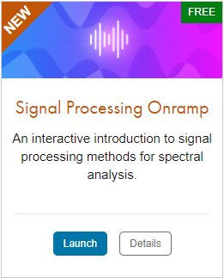
TO DO
Go to https://matlabacademy.mathworks.com/
Log in to your MathWorks account
Launch Signal Processing Onramp

Slide 29
Additional Learning Resources:
Follow @matlab_students on Instagram for tips/tricks, videos, and more!
This account is managed by MathWorks and is specifically for students!
Star the Awesome MATLAB Student Repository on GitHub and Bookmark the MATLAB & Simulink Resources for Students page.
Check out some of the other Student Program opportunities at MathWorks.

